Slide 1

A GENETIC-FROG LEAPING ALGORITHM FOR TEXT DOCUMENT CLUSTERING
By: Lubna Sulaiman Al-Henaki

Slide 2

Outline
Introduction
Background
Methodology Design
Experiments and Analysis
Conclusion and Future Work

Slide 3
INTRODUCTION

Slide 4
Problem Statement
Extracting useful information from large collections of data.
Large amounts of content (i.e., words) that is irrelevant to the topic or redundant can confuse the clustering process.
As a result, we need to use the feature selection method to select the most significant features that can improve text documents clustering.

Slide 5
Main Contributions
Developing a new framework for optimizing both feature selection using Genetic Algorithm (GA) and clustering text documents using Shuffled Frog-Leaping Algorithm (SFLA).
Both optimization stages cooperate together in finding the best overall solution.
Our choice of SFLA and GA for text document clustering is based on their success in handling clustering problems.

Slide 6
BACKGROUND

Slide 7
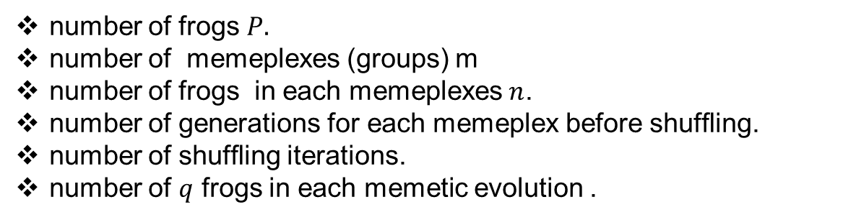
Shuffled Frog-Leaping Algorithm
1. Initialize the parameters of the algorithm
number of frogs $P.$
number of memeplexes (groups) m
number of frogs in each memeplexes$n$.
number of generations for each memeplex before shufﬂing.
number of shufﬂing iterations.
number of $q$ frogs in each memetic evolution .

Slide 8


Shuffled Frog-Leaping Algorithm
1. Initialize the parameters of the algorithm
2. Generate a random population (P=m*n) of frogs (solutions)
m = 4
n = 3
P=12

Slide 9
Shuffled Frog-Leaping Algorithm
1. Initialize the parameters of the algorithm
2. Generate a random population (P=m*n) of frogs (solutions)
3. Find the fitness of each solution
150
85
10
70
50
54
40
90
99
1%
44

Slide 10
Shuffled Frog-Leaping Algorithm
150
99
90
85
70
1. Initialize the parameters of the algorithm
2. Generate a random population (P=m*n) of frogs (solutions)
3. Find the fitness of each solution
4. Sort the frogs according to performance
54
50
44
40
10
1

Slide 11
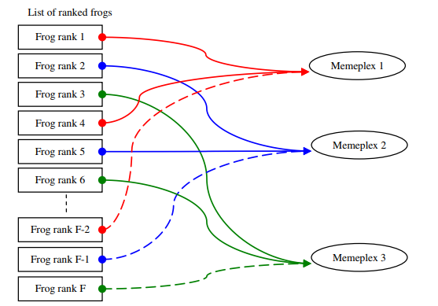
Shuffled Frog-Leaping Algorithm
1. Initialize the parameters of the algorithm
2. Generate a random population (P=m*n) of frogs (solutions)
3. Find the fitness of each solution
4. Sort the frogs according to performance
5. Separate the frogs into groups (memeplexes)
Figure 1: Memeplexes Overview

Slide 12
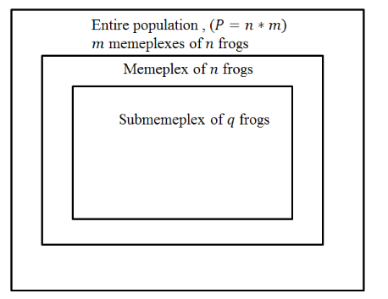
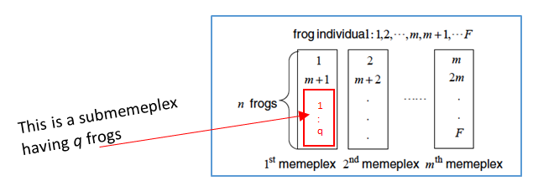
Shuffled Frog-Leaping Algorithm
1. Initialize the parameters of the algorithm
2. Generate a random population (P=m*n) of frogs (solutions)
3. Find the fitness of each solution
4. Sort the frogs according to performance
5. Separate the frogs into groups (memeplexes)
6.Memetic evolution for each memeplex
a.Generate a sub-memeplex in the current memeplex
Figure 2: Submemeplex Overview
For all memeplexes
Figure 3: Select Submemeplex

Slide 13
Shuffled Frog-Leaping Algorithm
1. Initialize the parameters of the algorithm
2. Generate a random population (P=m*n) of frogs (solutions)
3. Find the fitness of each solution
4. Sort the frogs according to performance
5. Separate the frogs into groups (memeplexes)
6.Memetic evolution for each memeplex
A. Generate a sub-memeplex in the current memeplex
B. Find the worst frog
C. Update the worst frog by combining it with best frog
D. Sort the frogs by performance
For all memeplexes

Slide 14
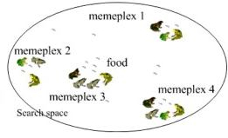
Shuffled Frog-Leaping Algorithm
1. Initialize the parameters of the algorithm
2. Generate a random population (P=m*n) of frogs (solutions)
3. Find the fitness of each solution
4. Sort the frogs according to performance
5. Separate the frogs into groups (memeplexes)
6. Memetic evolution for each memeplex
7. Shuffle the memeplexes and sort the population
Figure 4

Slide 15
Shuffled Frog-Leaping Algorithm
1. Initialize the parameters of the algorithm
2. Generate a random population (P=m*n) of frogs (solutions)
3. Find the fitness of each solution
4. Sort the frogs according to performance
5. Separate the frogs into groups (memeplexes)
6. Memetic evolution for each memeplex
7. Shuffle the memeplexes and sort the population
8. Update global best

Slide 16
METHODOLOGY

Slide 17
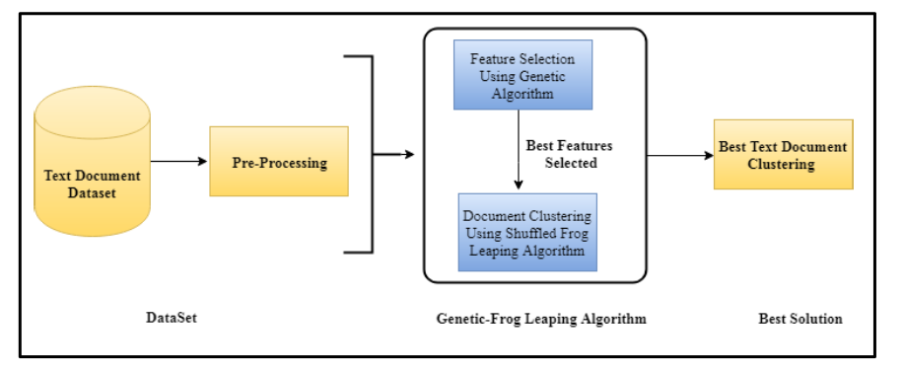
PROCEDURE
Figure 5: System Overview

Slide 18
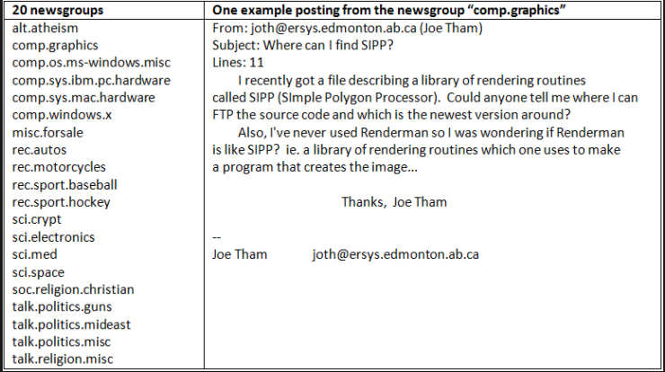
Dataset
20 newsgroups
Contains approximately 20,000 newsgroup articles, divided across 20 diﬀerent newsgroup categories such as computers, sports, and religion.
Figure 6: 20 newsgroups Categories

Slide 19
PROCEDURE
Figure 7: System Overview

Slide 20
Pre-Processing
Cleaning
Tokenizing
Removing Stop
words
Stemming
Figure 8: Pre-Processing Steps

Slide 21
Pre-Processing
Cleaning
The special characters such as”#”,”@”, and”/” were replaced by white spaces, we also replaced the abbreviations with full words, for example “can’t” replaced by “cannot”. In addition, we ignored the numbers and punctuation. Finally, we converted all characters to lowercase.
Tokenizing
For example, “Computer Science” will be “Computer” and “Science”.
Removing Stop words
For instance, “ a, in, the, of ”. The stop words used are common stop words list in the Natural Language Toolkit (NLTK) that contains 179 words .
Stemming
For example, “am”, “is”, and “are”, all words will be stemmed to the root word “be”. A popular stemmer algorithm, which is Porter algorithm were applied.

Slide 22
PROCEDURE
Figure 9: System Overview

Slide 23
PROCEDURE
Figure 10: System Overview

Slide 24
GA for Feature Selection
Solution Representation
Fitness Function
Selection Method
Crossover Operator
Mutation Operator
Replacement Strategies
Termination conditions

Slide 25
GA for Feature Selection
Solution Representation
Fitness Function
Selection Method
Crossover Operator
Mutation Operator
Replacement Strategies
Termination conditions

Slide 26
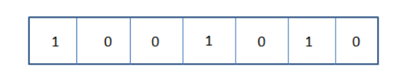
Solution Representation
Chromosomes in Genetic Algorithms are used to represent solutions. Every chromosome contains all features that are extracted from documents.
JAVA
C#
C++
PYTHON
R
PEARL
PHP
Figure 11: GA Solution Representation

Slide 27
GA for Feature Selection
Solution Representation
Fitness Function
Selection Method
Crossover Operator
Mutation Operator
Replacement Strategies
Termination conditions

Slide 28

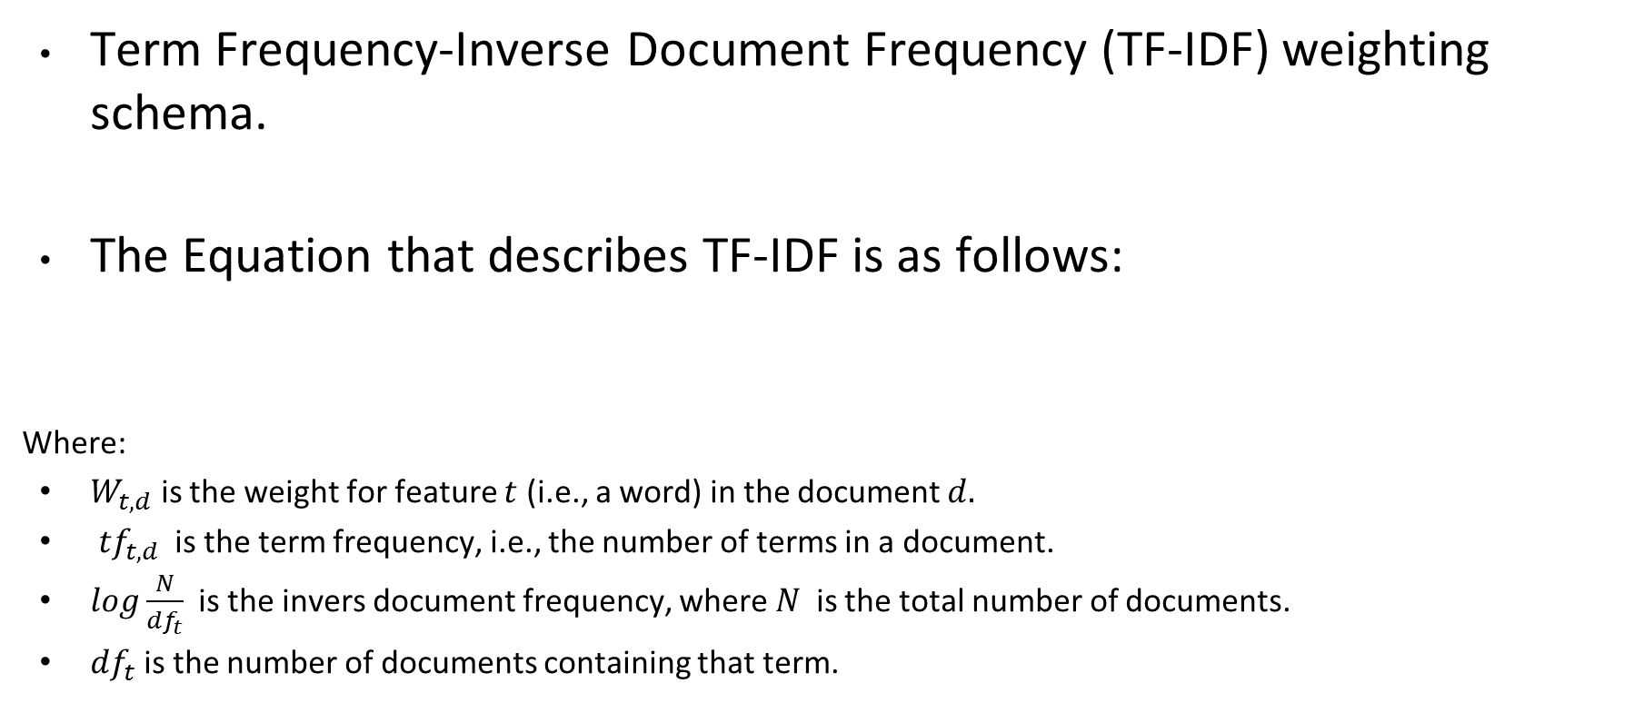
Fitness Function
Term Frequency-Inverse Document Frequency (TF-IDF) weighting schema.
The Equation that describes TF-IDF is as follows:
Where:
$W_{t,d}$ is the weight for feature $t$ (i.e., a word) in the document $d.$
${tf}_{t,d}$ is the term frequency, i.e., the number of terms in a document.
$log\frac{N}{{df}_{t}}$ is the invers document frequency, where $N$is the total number of documents.
${df}_{t}$is the number of documents containing that term.

Slide 29
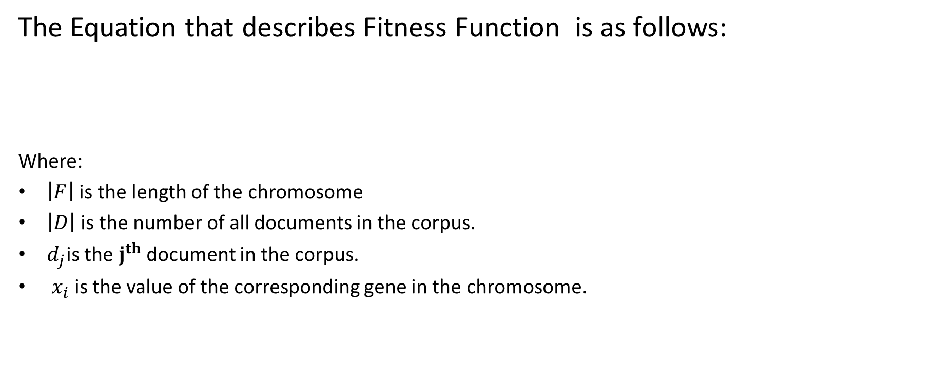
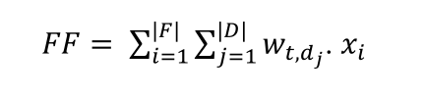
Fitness Function of GA
JAVA
C#
C++
PYTHON
R
PEARL
PHP
Figure 12: GA Solution Example

Slide 30
TF-IDF Lookup Table
We build a lookup table that contains the TF-IDF value for all
features in advance.
Table 1: TF-IDF Lookup Table
 | Accept | good | time | work
DOC 1 | 0.0000 | 0.1571 | 0.3758 | 0.0165
DOC 2 | 0.0165 | 0.0082 | 0.0843 | 0.1047
DOC 3 | 0.0082 | 0.0373 | 0.1252 | 0.1659
DOC 4 | 0.0679 | 0.4956 | 0.0000 | 0.1975

Slide 31
GA for Feature Selection
Solution Representation
Fitness Function
Selection Method
Crossover Operator
Mutation Operator
Replacement Strategies
Termination conditions

Slide 32
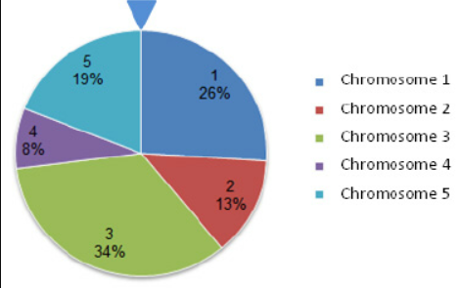
Selection Method
Roulette wheel selection method
The circular wheel is divided as value of fitness function. It is evident that the fitter the individual the greater it is portion in the pie, so it will obtain a higher chance of being selected as a parent for reproduction.
Figure 13:Roulette wheel selection method

Slide 33
GA for Feature Selection
Solution Representation
Fitness Function
Selection Method
Crossover Operator
Mutation Operator
Replacement Strategies
Termination conditions

Slide 34
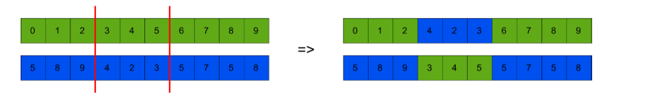
Crossover Operator
Two-Point Crossover
Figure 14: Two-Point Crossover

Slide 35
GA for Feature Selection
Solution Representation
Fitness Function
Selection Method
Crossover Operator
Mutation Operator
Replacement Strategies
Termination conditions

Slide 36
Mutation Operator
Multiple-Point Mutation
Figure 15: Multiple-Point Mutation

Slide 37
GA for Feature Selection
Solution Representation
Fitness Function
Selection Method
Crossover Operator
Mutation Operator
Replacement Strategies
Termination Conditions

Slide 38
Replacement Strategies
Steady State Replacement Strategy
Low fitness solutions in the population are replaced by the best of the newly generated solutions.

Slide 39
GA for Feature Selection
Solution Representation
Fitness Function
Selection Method
Crossover Operator
Mutation Operator
Replacement Strategies
Termination Conditions

Slide 40
Termination Conditions
Reaching one of the following conditions:
Reaching a maximum generation count.
No improvement in the population for ten iterations.

Slide 41
PROCEDURE
Figure 16: System Overview

Slide 42
SFLA for Text Document Clustering
Solution Representation
Fitness Function
Memplex Evolution (Crossover Operator)
Shufﬂing Process

Slide 43
SFLA for Text Document Clustering
Solution Representation
Fitness Function
Memplex Evolution (Crossover Operator)
Shufﬂing Process

Slide 44
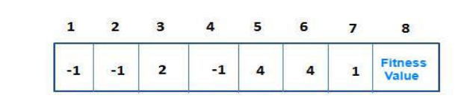
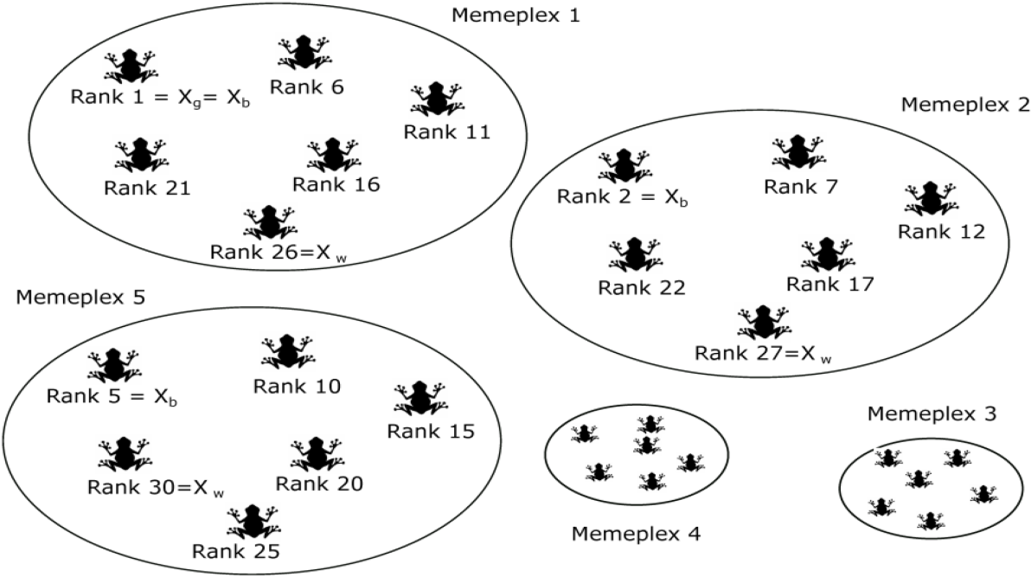
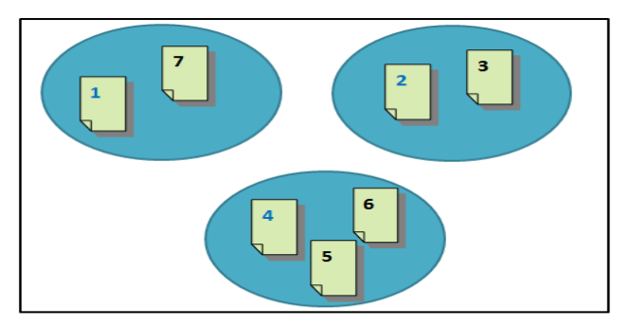
Solution Representation
medoids
Each frog is a clustering solution.
Medoids are randomly selected.
Each object is assigned to the nearest medoid.
Figure 18: Example of Clustering Solution Representation
Figure 19:Cluster Diagram of the Previous Solution in Figure 18
Figure 17: Population Overview

Slide 45
SFLA for Text Document Clustering
Solution Representation
Fitness Function
Memplex Evolution (Crossover Operator)
Shufﬂing process

Slide 46

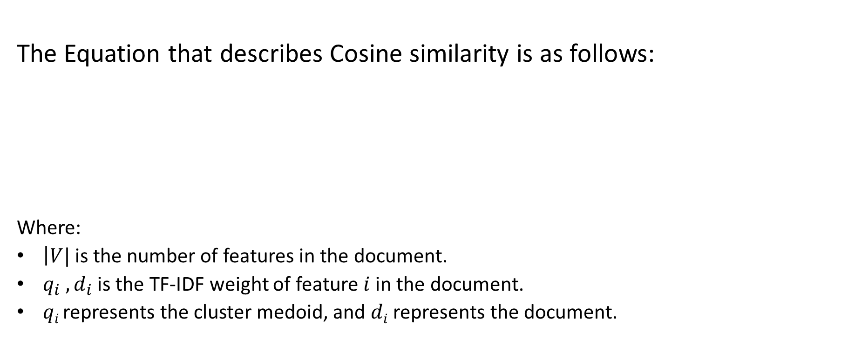
Fitness Function
The Equation that describes Cosine similarity is as follows:
Where:
$\left|V|\right.$is the number of features in the document.
$q_{i} , d_{i}$ is the TF-IDF weight of feature$i$ in the document.
$qi$represents the cluster medoid, and $di$ represents the document.
Inter-cluster
Similarity are
minimize

Slide 47
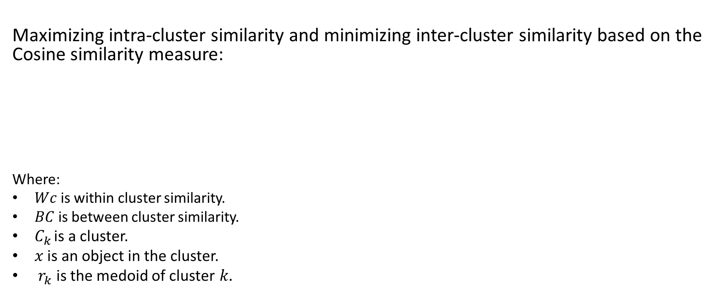



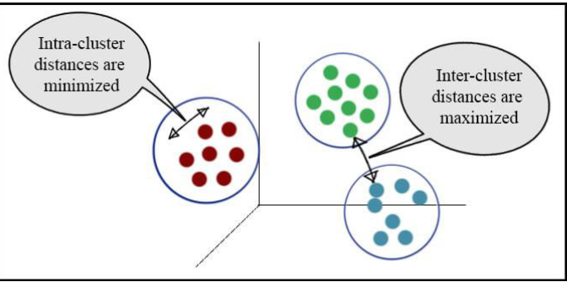
Fitness Function of SFLA
Intra-cluster
Similarity is
maximized
Inter-cluster
Similarity is
minimized
Figure 20: Fitness Function Clustering Overview

Slide 48
SFLA for Text Document Clustering
Solution Representation
Fitness Function
Memplex Evolution (Crossover Operator)
Shufﬂing process

Slide 49
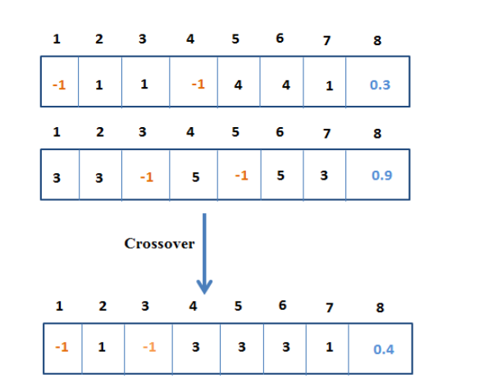
Memplex Evolution
Join and Split (J&S) crossover
Worst Frog
Best Frog
New Frog
Figure 21: Join and Spilt Crossover Example

Slide 50
SFLA for Text Document Clustering
Solution Representation
Fitness Function
Memplex Evolution (Crossover Operator)
Shufﬂing process

Slide 51
Shufﬂing Process
After a deﬁned number of evolution stages (local search), the shuffling process (global search) is applied.
Figure 22: Shuffling Process

Slide 52
Experiments and Analysis

Slide 53
Performance Evaluation
External measure (i.e., matching clustering structure to some prior
knowledge)
F-macro and F-micro
Internal measure (i.e., comparing different sets of clusters without a prior knowledge)

Slide 54

Implementation
Python programming language was selected to implement our approach due to its extensive support libraries, it being object-oriented, free, open-source and portable.
We implemented the algorithms in Python’s Anaconda execution environment.
Figure 23: Anaconda logo

Slide 55
Parameter Tuning for GA
Table 2: Parameter Tuning for the GA
Algorithm Name | Parameters Name | Parameters Value | Best Value
Genetic Algorithm | Population Size | 20, 50, and 100. | 50
 | Crossover rate | 0.75, 0.80, and 0.90. | 0.90
 | Mutation rates | 0.01, 0.05, and 0.10. | 0.10
 | Number of generations | 30, 50, and 100. | 100
 | Crossover operations | One point crossover, two point crossover, and uniform crossover. | Two-point crossover
 | Numbers of flip in mutation | 10, 20, 25, and 30. | 20-Bit flips

Slide 56
Parameter Tuning for SFLA
Table 3: Parameter Tuning for the SFLA
Algorithm Name | Parameters Name | Parameters Value | Best Value
Shuffled Frog Leaping Algorithm | Number 𝑚 of memeplexes, the number 𝑛 of frogs in a memeplex | 5, 10, and 20. | 20
 | Number 𝑞 of frogs in a submemeplex | 4, 5, and 8 . | 5
 | Number of generations for each memeplex (local search) | 5,10 ,and 20. | 10
 | Number of shufﬂing iterations (global search) | 10, 50, and 100. | 100

Slide 57
Results and Discussion
Table 5: Experiment Description
Experiment Number | Experiment Name
Experiment (1) | GA-SFLA Multiple Features Selection applied on Different Sizes of the Dataset.
Experiment (2) | GA-SFLA Multiple Features Selection applied on All Documents in the Dataset.
Experiment (3) | GA and K-means with Different Sizes of the Dataset .
Experiment (4) | GA and K-means tested on All Documents in the Dataset.
Experiment (5) | SFLA without Features Selection tested on Different Sizes of the Dataset.

Slide 58
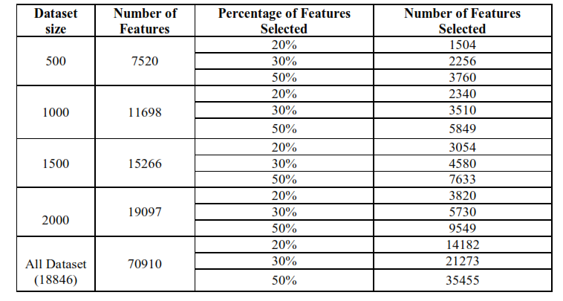
Features Selection
The number of selected features is an important element of robustness
of our proposed algorithm; hence it was studied.
Table 6: Number of Features Selection in Respect to Each Dataset Size

Slide 59
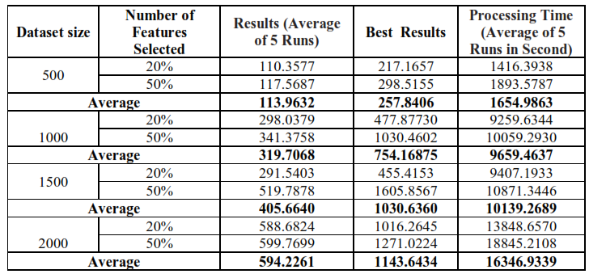
Experiment (1):GA-SFLA Multiple Features Selection applied on Different Sizes of the Dataset
For all experiments the number of clusters is equal to 20.
The purpose of this experiment was to assess the number of selected features for each collection size based on internal measure.
Table 7: Results of Multiple Runs of the GA-SFLA on Different Sizes of Datasets

Slide 60
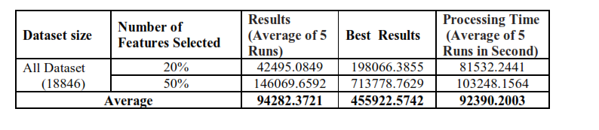
Experiment (2):GA-SFLA Multiple Features Selection applied on All Documents in the Dataset
The purpose of this experiment was to test our algorithm on the whole dataset with different number of features.
Table 8: Results of Multiple Runs of the GA-SFLA on All the Datasets

Slide 61
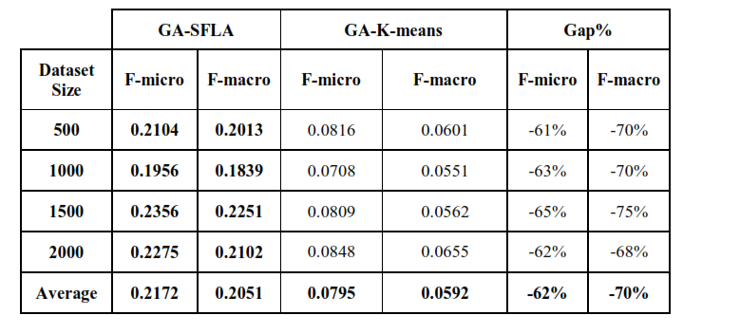
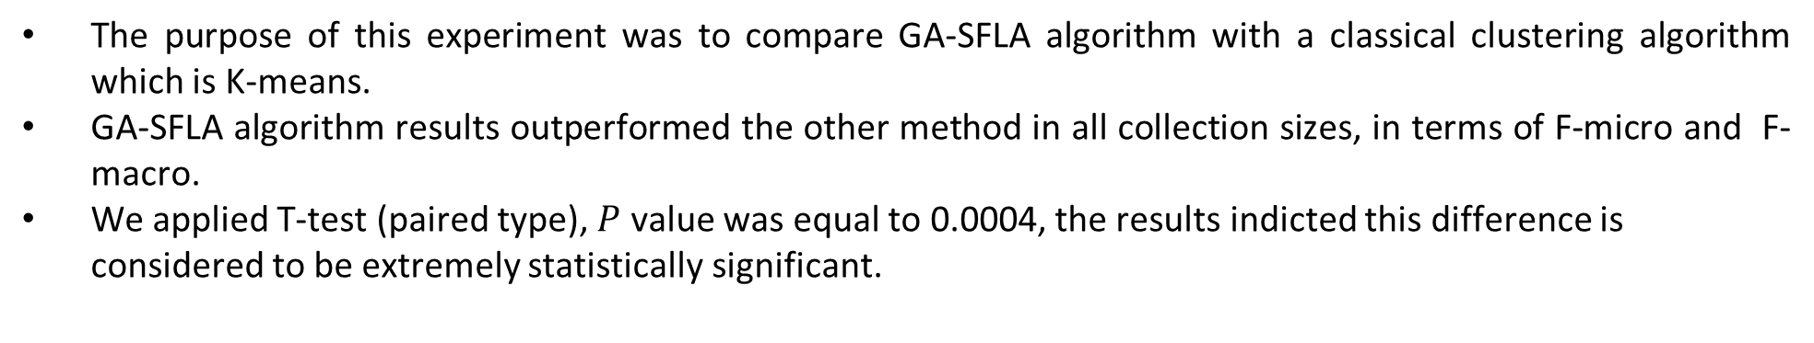
Experiment (3):GA and K-means with Different Sizes of the Dataset
The purpose of this experiment was to compare GA-SFLA algorithm with a classical clustering algorithm which is K-means.
GA-SFLA algorithm results outperformed the other method in all collection sizes, in terms of F-micro and F-macro.
We applied T-test (paired type), $P$ value was equal to 0.0004, the results indicted this difference is considered to be extremely statistically significant.
Table 9: Comparison Results Between SFLA and K-means using the GA Feature Selection

Slide 62
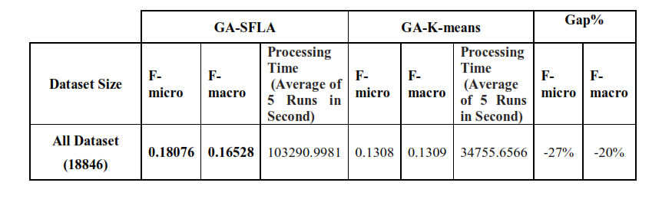
Experiment (4):GA and K-means tested on All Documents in the Dataset
The purpose of this experiment was to assess and compare the GA-SFLA and the GA-K-means clustering solutions for whole text documents dataset.
GA-SFLA algorithm results outperformed the other method in whole text collection sizes, in terms of F-micro and F-macro.
Table 10: Comparison Results Between SFLA and K-means Applied in Whole Dataset

Slide 63
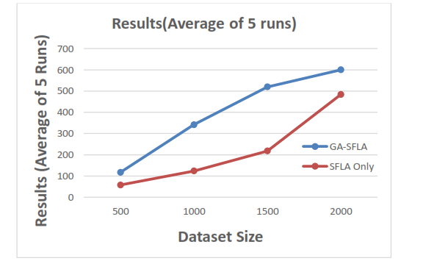
Experiment (5):SFLA without Features Selection tested on Different Sizes of the Dataset
The main goal of this experiment is to assess the benefit of feature selection in text documents clustering process by comparing the results obtained from the analysis of GA-SFLA and SFLA only (without features selection phase)
We applied T-test (paired type). The results indicated that this difference is considered to be statistically significant.
Figure 24: GA-SFLA and SFLA intra-cluster Vs inter-cluster similarity Results

Slide 64
Conclusion and Future Work

Slide 65
Limitation and Challenges
The huge processing time needed by our algorithm.
Identifying the best programming language was time-consuming. We started by trying Java. However, due to some limitations, like difficulty in dealing with a text dataset, we used Python.
Implementing each algorithm from scratch, especially the objective function was not an easy task; this process was very time consuming.
We used a supercomputer in the Bioinformatics Research Group lab. I needed to revisit the research group lab many times and stay for long hours.

Slide 66
Summary
Document clustering help in identifying useful information.
In this study, we proposed a method that combines a Genetic Algorithm and a Shufﬂed Frog-Leaping Algorithm to identify the best text clustering solution.
After multiple experiments were compared and analyzed, we found that using GA-SFLA on the 20Newsgroup dataset greatly helped to enhance the text document clustering, compared to the classical K-means clustering.

Slide 67
Future Work
This experiment will be applied to other popular text datasets.
Another feature selection technique can be used.
Improving the cohesiveness of the resulting clusters and optimizing the processing time of our proposed algorithm.
Other representation methods in the Genetic Algorithm can be applied.

Slide 68
Thank You

